Slide 1
IN404 Unit 1
Cyber Warfare & Automated Bots
Dr. Sonali Sen Baidya

Slide 2
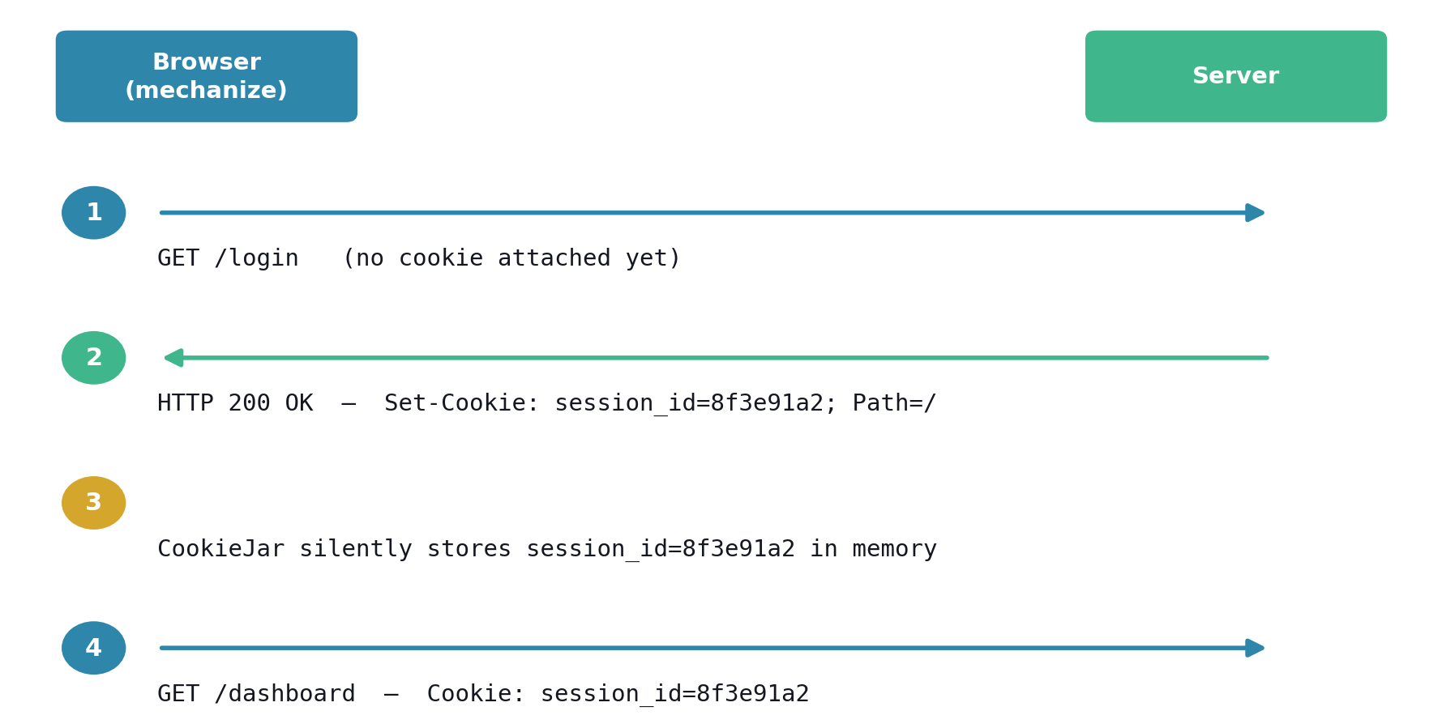
Example: The Cookie Exchange, Step by Step

Slide 3
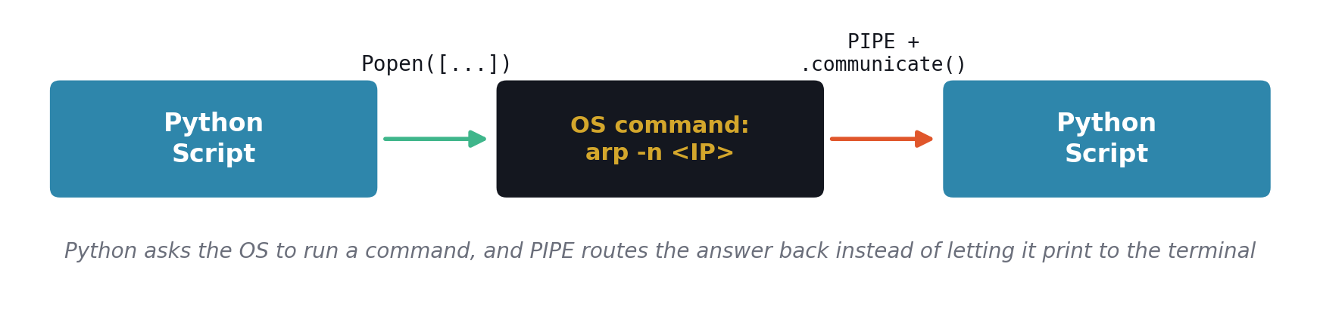
Example: What PIPE does

Slide 4
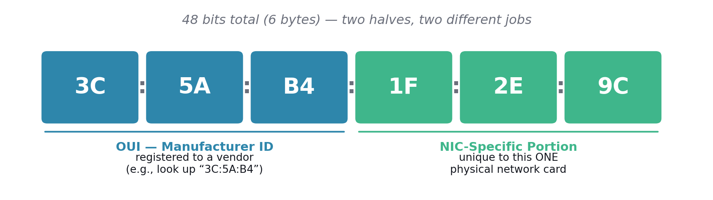
Example: Anatomy of a Real MAC Address
Notes:
Run IN404_Unit1_1.py option 2 against a device on your network, take the MAC it returns, and look up its OUI. Turning an abstract hex string into “oh, that's a Cisco switch” is exactly the kind of fingerprinting a reconnaissance tool performs.

Slide 5
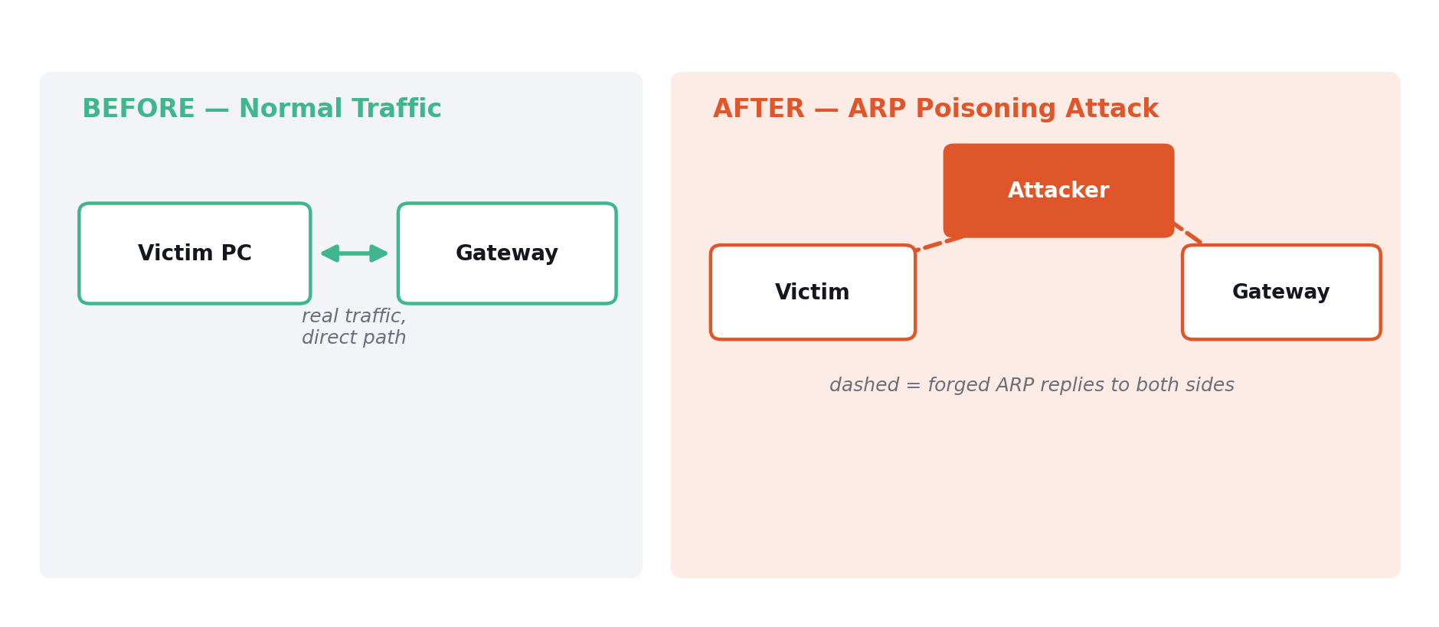
Example: ARP Spoofing
WHAT'S HAPPENING
The attacker sends unsolicited, forged ARP replies to both sides: it tells the Victim “I am the gateway” and tells the Gateway “I am the Victim.” Every packet the Victim sends now routes through the Attacker before reaching the real Gateway — the same IP↔MAC lookup performs legitimately.

Slide 6
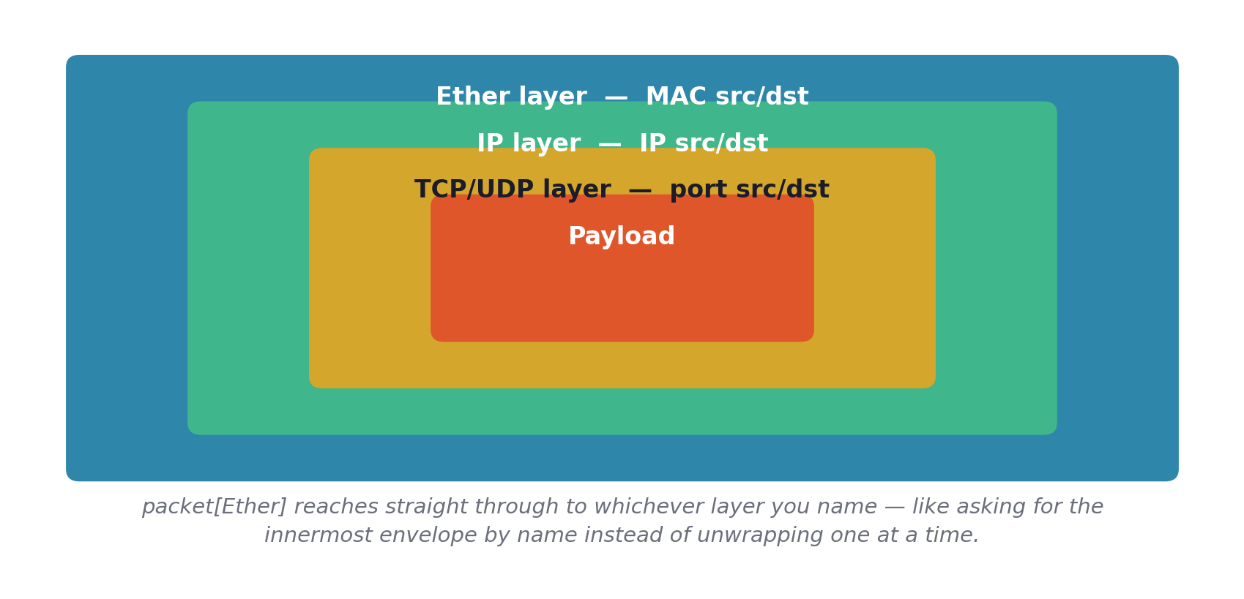
Packets Are Nested Envelopes

